Slide 1
Building models

Slide 2
Today’s goals – starting foundations
Terminology for understanding how Bayesian cognitive models are constructed and interpreted
Notation for representing models in equations and plate notation
First pass on building a very simple model of binary choice

Slide 3
What do we want from cognitive models
Answer to “Why” questions about behaviour
“Why” questions – reasons for behavior
Behaviourist reasons – external causes
Cognitivist reasons – unobservable internal causes
Answers in terms of Latent properties/variables

Slide 4
Overview
Graphical models, latent variables and plate notation
Graphical models as models of probability
Comparing models

Slide 5
Overview
Graphical models, latent variables and plate notation
Graphical models as models of probability
Comparing models

Slide 6
Example: observed and latent variables
Why do students get the grades they get?
Reasons?
Work
Aptitude
Interest
Social
Luck

Slide 7
Example: observed and latent variables
Why do students get the grades they get?
Reasons?
Work (class attendance, reading, homework)
Aptitude
Interest
Social
Luck

Slide 8
Example: observed and latent variables
Why do students get the grades they get?
Reasons?
Work (class attendance, reading, homework)
Aptitude (prior skill)
Interest
Social
Luck

Slide 9
Example: observed and latent variables
Why do students get the grades they get?
Reasons?
Work (class attendance, reading, homework)
Aptitude (prior skill)
Interest (intrinsic and extrinsic motivation)
Social
Luck

Slide 10
Example: observed and latent variables
Why do students get the grades they get?
Reasons?
Work (class attendance, reading, homework)
Aptitude (prior skill)
Interest (intrinsic and extrinsic motivation)
Social (study group dynamics, parents’ education)
Luck

Slide 11
Example: observed and latent variables
Why do students get the grades they get?
Reasons?
Work (class attendance, reading, homework)
Aptitude (prior skill)
Interest (intrinsic and extrinsic motivation)
Social (study group dynamics, parents’ education)
Luck (examiner, censor)

Slide 12
Example: observed and latent variables
Why do students get the grades they get?
Reasons?
Work (class attendance, reading, homework)
Aptitude (prior skill)
Interest (intrinsic and extrinsic motivation)
Social (study group dynamics, parents’ education)
Luck (examiner, censor)
Which are observable and which are latent

Slide 13
Simplified: observed and latent variables
Observed
Attendance (A)
Reading (R)
Parents Ed. (P)
Examiner (E)
Latent
Skill (S)
Motivation (M)

Slide 14
Let’s construct a model – Graph 1
Observed
Attendance (A)
Reading (R)
Parents Ed. (P)
Examiner (E)
P
E
R
S
A
M
Latent
G
Skill (S)
Motivation (M)

Slide 15
Indicating observed variables – shaded nodes
Observed
Attendance (A)
Reading (R)
Parents Ed. (P)
Examiner (E)
P
E
R
S
A
M
Latent
G
Skill (S)
Motivation (M)
How do we interpret this model?
Model 1: Everything is a direct cause of grades

Slide 16
Let’s construct a model – Graph 2
Observed
P
Attendance (A)
Reading (R)
Parents Ed. (P)
Examiner (E)
M
R
S
Latent
A
G
E
Skill (S)
Motivation (M)
How do we interpret this model?

Slide 17
Indicating multiple measures – Plate notation
Observed
M_{s}
P_{s}
Attendance (A)
Reading (R)
Parents Ed. (P)
Examiner (E)
R_{s}
S_{s}
Latent
A_{s}
G_{s}
E_{s}
Skill (S)
Motivation (M)
s students

Slide 18
From graphs to models
Questions we’ll address
M_{s}
P_{s}
What do the arrows means?
How can we apply the model to data?
How do we learn about the latent variables?
Where is the actual model?
R_{s}
S_{s}
A_{s}
G_{s}
E_{s}
s students

Slide 19
Summary: Concepts so far
Graphical model (Directed Acyclic Graph)
Latent and observed variables
Plate notation for visualizing graphs

Slide 20
Overview
Graphical models, latent variables and plate notation
Graphical models as models of probability
Comparing models

Slide 21
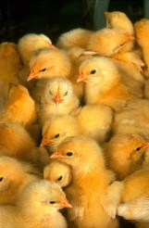
A simpler example chicken sexing
Determining chick gender in a commercial plant
Well paid job requiring skill
Chicken sexing competitions
Model: Binary discrimination

Slide 22
Variables
Observable
Correct/incorrect guess - G
Latent
Skill – θ
Interpretation: p(correct G)
θ
G
Is this right? Can we add more?

Slide 23
Variables
Observable
Correct/incorrect guess - G
Latent
Skill – θ
Interpretation: p(correct G)
θ
G_{t}
t trials
Multiple trials

Slide 24
Variables
Observable
Correct/incorrect guess - G
Latent
Skill – θ
Interpretation: p(correct G)
θ_{s}
G_{s,t}
t trials
s subjects
Multiple subjects

Slide 25
From graphs to models
Questions
What do the arrows means?
How can we apply the model to data?
How do we learn about the latent variables?
Where is the actual model?
θ_{s}
G_{s,t}
t trials
s subjects

Slide 26
From graphs to models
Questions
What do the arrows means?
How can we apply the model to data?
How do we learn about the latent variables?
Where is the actual model?
θ_{s}
G_{s,t}
t trials
s subjects

Slide 27
Graphical models are probability models
Latent “variables” = unknown parameters of distributions
Arrow = “sampled from”, or better “distributed as”
Interpretation: guess-accuracy follows some distribution with parameter θ
What is the distribution?
θ_{s}
G_{s,t}
t trials
s subjects

Slide 28

Binomial distribution – the intuition
Fair coin – p(.5) heads
Double sided coin – p(1) heads
A weighted coin – p(.7) heads
More generally – p(θ) heads
θ is the bias on the coin

Slide 29
Binomial distribution – the intuition
Complete guess – p(.5) correct
Perfect expert – p(1) correct
Trainee – p(.7) correct
More generally – p(θ) correct
θ is the skill level

Slide 30
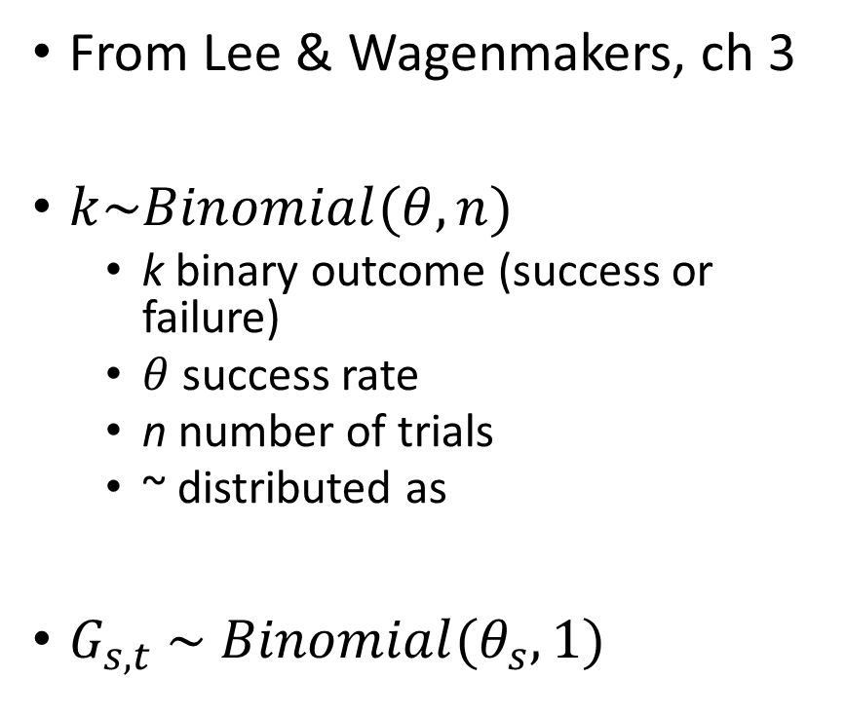
Binomial distribution – notation
From Lee & Wagenmakers, ch 3
$k\sim Binomial(θ,n)$
k binary outcome (success or failure)
$θ$ success rate
n number of trials
~ distributed as
$G_{s,t} \sim Binomial(θ_{s},1)$
θ_{s}
G_{s,t}
t trials
s subjects

Slide 31
From graphs to models
Questions
What do the arrows means?
How can we apply the model to data?
How do we learn about the latent variables?
Where is the actual model?
θ_{s}
G_{s,t}
t trials
s subjects

Slide 32
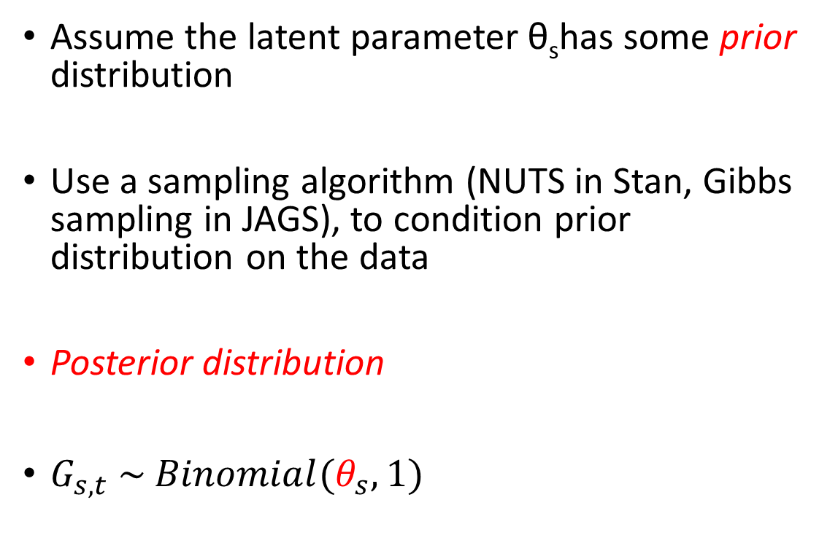
Bayesian inference
Assume the latent parameter θ_{s}has some prior distribution
Use a sampling algorithm (NUTS in Stan, Gibbs sampling in JAGS), to condition prior distribution on the data
Posterior distribution
$G_{s,t} \sim Binomial(θ_{s},1)$
θ_{s}
G_{s,t}
t trials
s subjects

Slide 33
Sampling intuitions
Forward simulation
Use knowledge of parameters to simulate data
R code: rbinom(1,1,.5) to simulate flipping a fair coin
rbinom(10,1,.5) to simulate ten coin flips
Output: 0 0 1 1 0 1 0 1 0 1. …..
Prior → Simulated Data
Reverse inference
List of data: 0 0 1 1 0 1 0 1 0 1. …..
JAGS code: dbinom(1,1,θ)
Run thousands of simulations with values of θ sampled from the joint posterior distribution of the model, to guess probability that any possible θ produced the data
Prior + Data → Posterior

Slide 34

Bayesian inference
How do we select a prior?
$G_{s,t} \sim Binomial(θ_{s},1)$
What values could $θ_{}$possibly take
θ_{s}
G_{s,t}
t trials
s subjects

Slide 35
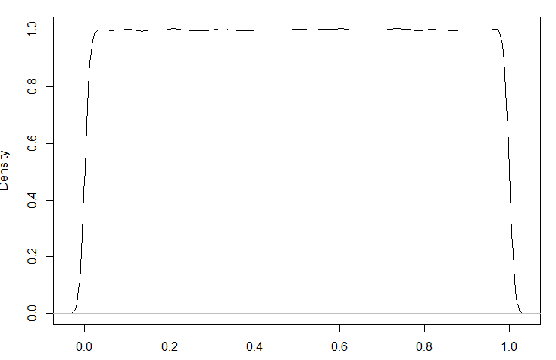
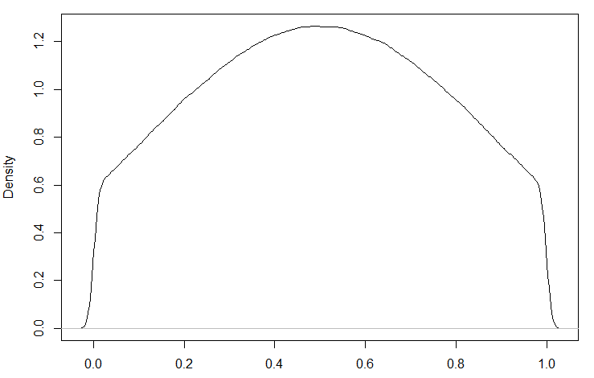
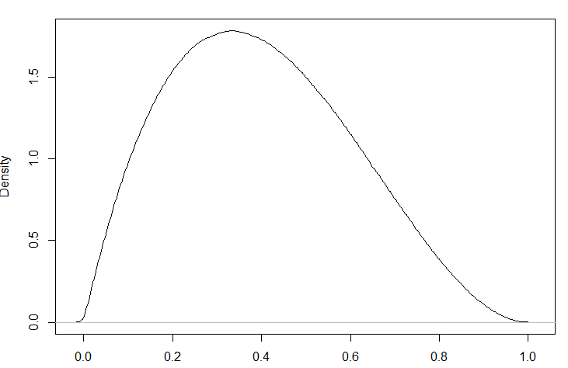
Possible prior distributions for θ
θ is a probability – must be between 0 and 1
Uniform distribution
Truncated normal distribution
Beta distribution
Which one should we select and why?

Slide 36

Beta distribution
$θ_{s} \sim Beta(α,β)$
$G_{s,t} \sim Binomial(θ_{s},1)$
θ – success rate (skill as chicken sexer – what we want to know)
α – number of successes
Β – number of failures
“Conjugate prior”

Slide 37
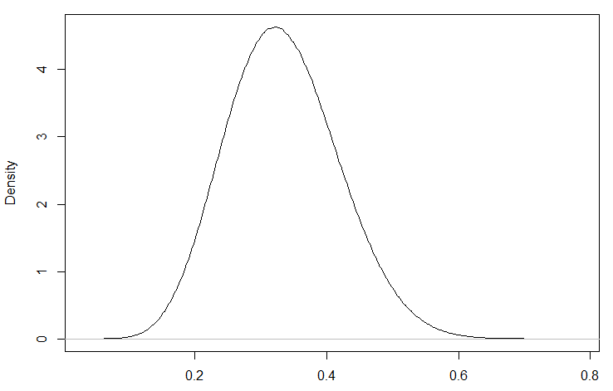
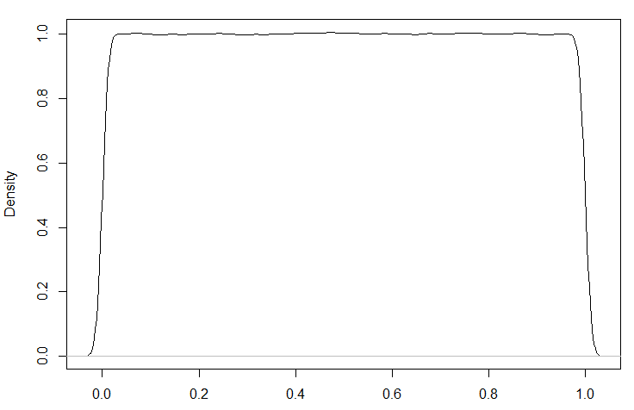
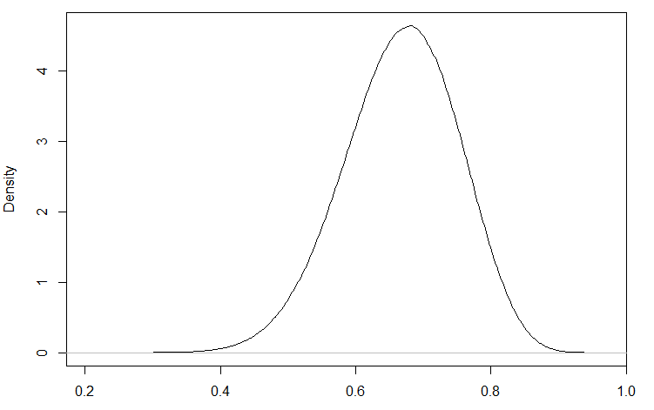
Examples of Beta distribution
α = 10
Β = 20
(.33 most likely value of θ)
α = 1
Β = 1
We know nothing
α = 20
Β = 10
(.66 most likely value of θ)
α – number of successes
Β – number of failures

Slide 38
From graphs to models
Questions
What do the arrows means?
How can we apply the model to data?
How do we learn about the latent variables?
Where is the actual model?
θ_{s}
G_{s,t}
t trials
s subjects

Slide 39

Model specification
$θ_{s} \sim Beta(1,1)$
$G_{s,t} \sim Binomial(θ_{s},1)$
θ_{s}
G_{s,t}
t trials
s subjects

Slide 40
Overview
Graphical models, latent variables and plate notation
Graphical models as models of probability
Comparing models

Slide 41
Learning chicken sexing
Starting chicken sexers improve with practice
How could we model learning
Model: improvement in binary discrimination over time
Change in θ

Slide 42
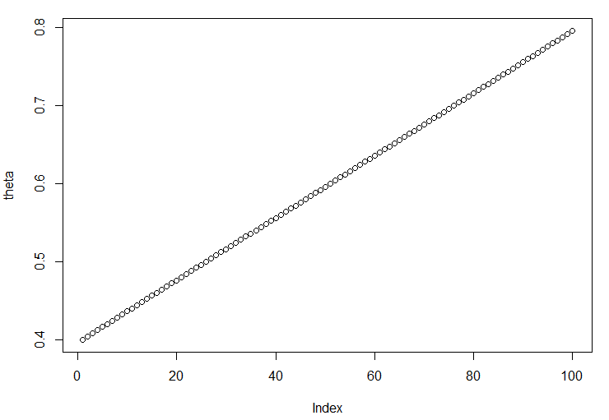
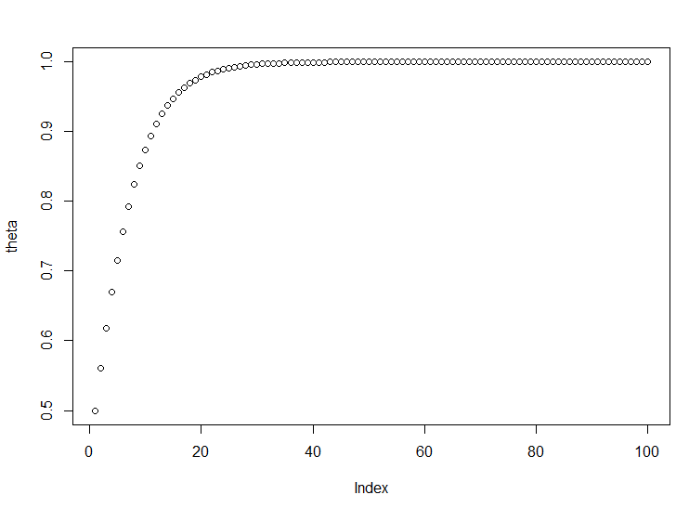
Introducing some theory
How do we expect skill θ to change over time?
Or some other complex form?

Slide 43
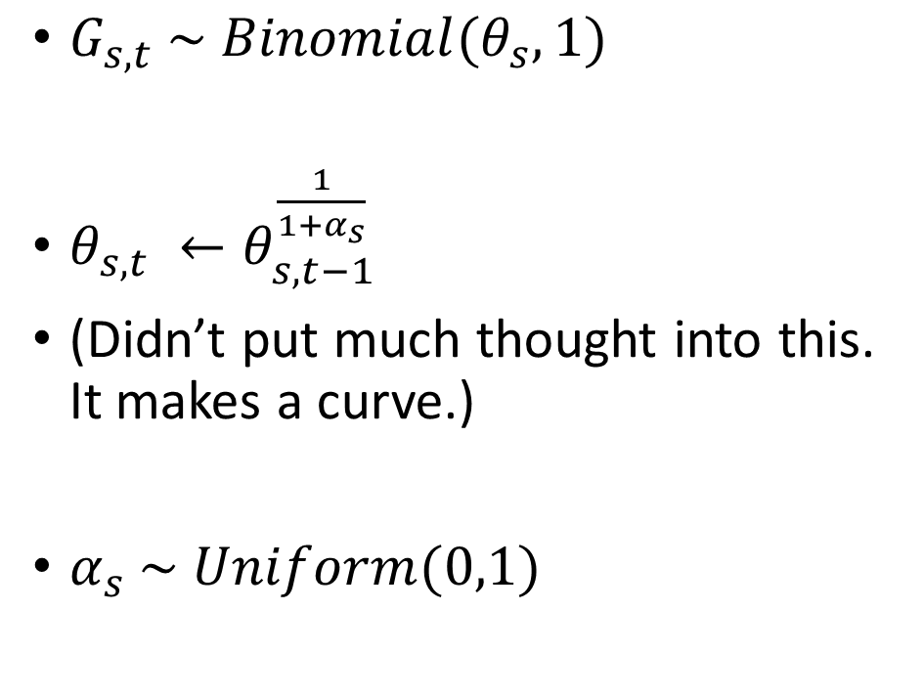
Learning model specification
α_{s}
$G_{s,t} \sim Binomial(θ_{s},1)$
$θ_{s,t} ←θ_{s,t−1}^{\frac{1}{{1+α}_{s}}}$
(Didn’t put much thought into this. It makes a curve.)
$α_{s} \sim Uniform(0,1)$
θ_{s,t-1}
θ_{s,t}
G_{s,t}
t trials
s subjects

Slide 44
Plate notation conventions
α_{s}
Shaded – data, unshaded – latent
Square – discrete, circle – continuous
Double – deterministic, single – stochastic
Stochastic – need a prior
θ_{s,t-1}
θ_{s,t}
G_{s,t}
t trials
s subjects

Slide 45
Concepts from today
Graphical models are systems of interlocking equations, representing relationships between probability distributions
Models are represented using equations, and can be schematized using plate notion (if helpful)
Latent parameters are terms which describe something about the distributions figuring in equations – unshaded nodes in plate notation
Latent parameters in cognitive models should be psychologically interpretable
We start inference by assigning prior distributions to all latent parameters
We use sampling (Stan or JAGS) to condition the model on data, inferring posterior distributions for latent parameters

Slide 46
Next class
Demonstration
We’ll build and evaluate our chicken sexer models
Compare prior and posterior distributions for simulated data
Run model and parameter recovery studies

